Slide 1
Formal verification of P Systems Using NuSMV
Luculescu Teodor - 351
Mihalache Sebastian-Ștefan - 352
Neculae Andrei-Fabian - 352

Slide 2
Cuprins
P System
NuSMV
Operația de împărțire
Numerele Fibonacci
Bibliografie
Link Github - https://github.com/Andrei137/Proiect-MFIS

Slide 3
P System
Un model computațional inspirat de structura și funcționarea celulei vii
Oferă un cadru puternic și flexibil pentru modelarea și analiza sistemelor bio-inspirate
Organizare ierarhică de compartimente separate prin membrane Fiecare compartiment conține:
Un multiset finit de obiecte
Un set finit de reguli
Alte compartimente (opțional)

Slide 4
NuSMV
= New Symbolic Model Verifier
Este un verificator de modele bazat pe logică temporală, care permite verificarea automată a proprietăților specificate asupra unui model formalizat al unui sistem
P Systems pot fi modelate ca structuri de tranziție finite (Kripke structures)
Verificarea formală oferă garanții riguroase privind corectitudinea sistemului și consolidează rezultatele obținute printr-o analiză exhaustivă
Putem verifica:
Invarianți (proprietăți care trebuie să fie mereu adevărate).
Proprietăți temporale (ce se întâmplă în timp)

Slide 5
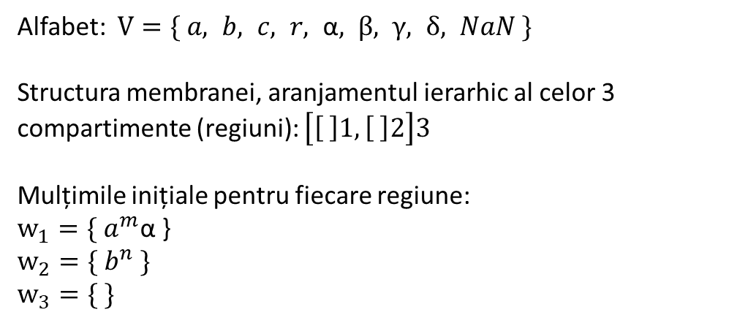
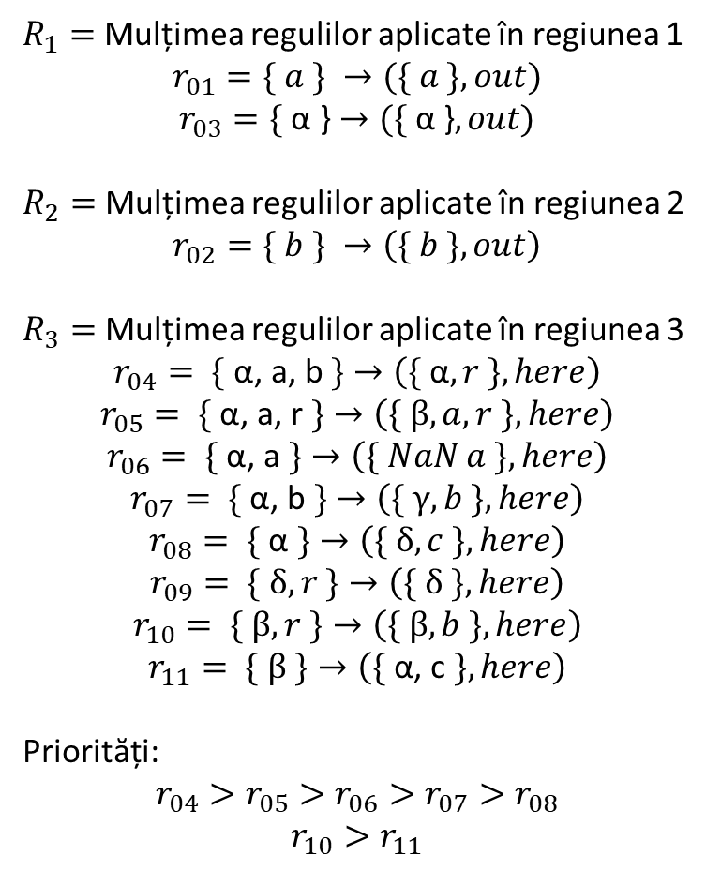


Reprezentarea operații de împărțire
Alfabet: $V=\{ a, b, c, r, \text{α}, β, γ, δ, NaN \}$
Structura membranei, aranjamentul ierarhic al celor 3 compartimente (regiuni): $\left[\left[ \right]1, \left[ \right]2\right]3$
Mulțimile inițiale pentru fiecare regiune:
$$w_{1}={\{ a}^{m}\text{α}\text{ \}}$$
$$w_{2}={\{ b}^{n} \}$$
$$w_{3}=\{ \}$$
$R_{1}=$ Mulțimea regulilor aplicate în regiunea 1
$$r_{01}=\{ a \} →(\{ a \}, out)$$
$$r_{03}=\text{\{ }\text{α}\text{ \}}→(\text{\{ }\text{α}\text{ \}}, out)$$
$R_{2}=$ Mulțimea regulilor aplicate în regiunea 2
$$r_{02}=\{ b \} →\left(\{ b \}, out\right)$$
$R_{3}=$ Mulțimea regulilor aplicate în regiunea 3
$$r_{04}=\text{ \{ }\text{α}\text{, }\text{a}\text{, }\text{b} \text{\}}→\left(\{ \text{α}, r \}, here\right)$$
$$r_{05}=\text{ \{ }\text{α}\text{, }\text{a}\text{, }\text{r} \text{\}}→\left(\{ β, a,r \}, here\right)$$
$$r_{06}=\text{ \{ }\text{α}\text{, }\text{a} \text{\}}→\left(\{ NaN a \}, here\right)$$
$$r_{07}=\text{ \{ }\text{α}\text{, }\text{b} \text{\}}→\left(\{ γ, b \}, here\right)$$
$$r_{08}=\text{ \{ }\text{α} \text{\}}→\left(\{ δ, c \}, here\right)$$
$$r_{09}=\text{ \{} δ, r \text{\}}→\left(\{ δ \}, here\right)$$
$$r_{10}=\text{ \{} β, r \text{\}}→\left(\{ β,b \}, here\right)$$
$$r_{11}=\text{ \{} β \text{\}}→\left(\{ \text{α}\text{, }\text{c} \}, here\right)$$
Priorități:
$$r_{04}>r_{05}>r_{06}>r_{07}>r_{08}$$
$$r_{10}>r_{11}$$
{ }
$${\{ a}^{m}\text{, }\text{α}\text{ \}}$$
$${\{ b}^{n} \}$$

Slide 6





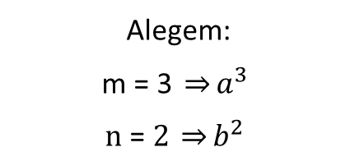

Exemplu pentru operația de împărțire
{ }
$$\{ \}$$
$${\{ a}^{m}\text{, }\text{α}\text{ \}}$$
$${\{ a}^{3}\text{α}\text{ \}}$$
$$Pasul 0$$
$${\{ b}^{n} \}$$
$${\{ b}^{2} \}$$
Alegem:
$$\text{m}\text{ = 3 }\underset{⇒}{}a^{3}$$
$$\text{n}\text{ = }2 \underset{⇒}{}b^{2}$$

Slide 7





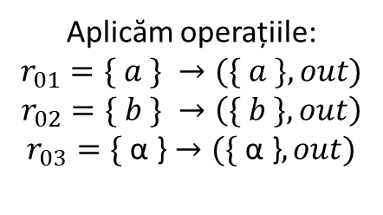



Exemplu pentru operația de împărțire
$$\{ \}$$
{ }
$${\{ a}^{3}\text{,} b^{2}\text{, }\text{α}\text{ \}}$$
$$\{ \}$$
$$\{ \}$$
$${\{ a}^{m}\text{α}\text{ \}}$$
$${\{ a}^{3}\text{α}\text{ \}}$$
$${\{ a}^{3}\text{α}\text{ \}}$$
$$Pasul 1$$
$${\{ b}^{n} \}$$
$${\{ b}^{2} \}$$
$${\{ b}^{2} \}$$
$$\{ \}$$
Aplicăm operațiile:
$$r_{01}=\{ a \} →(\{ a \}, out)$$
$$r_{02}=\{ b \} →\left(\{ b \}, out\right)$$
$$r_{03}=\text{\{ }\text{α}\text{ \}}→(\text{\{ }\text{α}\text{ \}}, out)$$

Slide 8





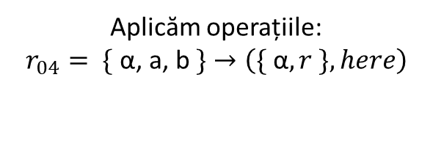


Exemplu pentru operația de împărțire
$$\{ \}$$
$${\{ a}^{2}\text{,}{ b}^{1}\text{,}{ r}^{1}\text{, }\text{α} \text{\}}$$
{ }
$${\{ a}^{3}\text{,} b^{2}\text{, }\text{α}\text{ \}}$$
$$\{ \}$$
$${\{ a}^{3}\text{,} b^{2}\text{, }\text{α}\text{ \}}$$
$$\{ \}$$
$$\{ \}$$
$$\{ \}$$
$${\{ a}^{3}\text{α}\text{ \}}$$
$${\{ a}^{m}\text{α}\text{ \}}$$
$${\{ a}^{3}\text{α}\text{ \}}$$
$$Pasul 2$$
$${\{ b}^{n} \}$$
$${\{ b}^{2} \}$$
$${\{ b}^{2} \}$$
$$\{ \}$$
$$\{ \}$$
$$\{ \}$$
Aplicăm operațiile:
$$r_{04}=\text{ \{ }\text{α}\text{, }\text{a}\text{, }\text{b} \text{\}}→\left(\{ \text{α}, r \}, here\right)$$

Slide 9




Exemplu pentru operația de împărțire
$$\{ \}$$
$${\{ a}^{2}\text{,}{ b}^{1}\text{,} \text{α}\text{,}{ r}^{1} \text{\}}$$
$${\{ a}^{1}\text{,}{ r}^{2}\text{, }\text{α}\text{\}}$$
{ }
$${\{ a}^{3}\text{,} b^{2}\text{, }\text{α}\text{ \}}$$
$$\{ \}$$
$${\{ a}^{3}\text{,} b^{2}\text{, }\text{α}\text{ \}}$$
$${\{ a}^{2}\text{,}{ b}^{1}\text{,}{ r}^{1}\text{, }\text{α} \text{\}}$$
$$\{ \}$$
$$\{ \}$$
$$\{ \}$$
$$\{ \}$$
$${\{ a}^{3}\text{α}\text{ \}}$$
$$\{ \}$$
$${\{ a}^{m}\text{α}\text{ \}}$$
$${\{ a}^{3}\text{α}\text{ \}}$$
$$Pasul \text{3}$$
$${\{ b}^{n} \}$$
$${\{ b}^{2} \}$$
$${\{ b}^{2} \}$$
$$\{ \}$$
$$\{ \}$$
$$\{ \}$$
$$\{ \}$$
$$\{ \}$$
Aplicăm operațiile:
$$r_{04}=\text{ \{ }\text{α}\text{, }\text{a}\text{, }\text{b} \text{\}}→\left(\{ \text{α}, r \}, here\right)$$

Slide 10








Exemplu pentru operația de împărțire
$${\{ a}^{1}\text{,}{ r}^{2}\text{,} β \text{\}}$$
$$\{ \}$$
$${\{ a}^{2}\text{,}{ b}^{1}\text{,} \text{α}\text{,}{ r}^{1} \text{\}}$$
$${\{ a}^{1}\text{, }\text{α}\text{,}{ r}^{2} \text{\}}$$
{ }
$${\{ a}^{3}\text{,} b^{2}\text{, }\text{α}\text{ \}}$$
$$\{ \}$$
$${\{ a}^{3}\text{,} b^{2}\text{, }\text{α}\text{ \}}$$
$${\{ a}^{2}\text{,}{ b}^{1}\text{,} \text{α}\text{,}{ r}^{1} \text{\}}$$
$${\{ a}^{1}\text{,}{ r}^{2}\text{, }\text{α}\text{\}}$$
$$\{ \}$$
$$\{ \}$$
$$\{ \}$$
$$\{ \}$$
$$\{ \}$$
$${\{ a}^{3}\text{α}\text{ \}}$$
$$\{ \}$$
$$\{ \}$$
$${\{ a}^{m}\text{α}\text{ \}}$$
$${\{ a}^{3}\text{α}\text{ \}}$$
$$Pasul \text{4}$$
$${\{ b}^{n} \}$$
$${\{ b}^{2} \}$$
$${\{ b}^{2} \}$$
$$\{ \}$$
$$\{ \}$$
$$\{ \}$$
$$\{ \}$$
$$\{ \}$$
$$\{ \}$$
$$\{ \}$$
Aplicăm operațiile:
$$r_{05}=\text{ \{ }\text{α}\text{, }\text{a}\text{, }\text{r} \text{\}}→\left(\{ β, a,r \}, here\right)$$

Slide 11






Exemplu pentru operația de împărțire
$${\{ a}^{1}\text{,} { b}^{1}\text{,}{ r}^{1}, β \text{\}}$$
$${\{ a}^{1}\text{,} β\text{,}{ r}^{1} \text{\}}$$
$$\{ \}$$
$${\{ a}^{2}\text{,}{ b}^{1}\text{,} \text{α}\text{,}{ r}^{1} \text{\}}$$
$${\{ a}^{1}\text{, }\text{α}\text{,}{ r}^{2} \text{\}}$$
{ }
$${\{ a}^{3}\text{,} b^{2}\text{, }\text{α}\text{ \}}$$
$$\{ \}$$
$${\{ a}^{3}\text{,} b^{2}\text{, }\text{α}\text{ \}}$$
$${\{ a}^{2}\text{,}{ b}^{1}\text{,} \text{α}\text{,}{ r}^{1} \text{\}}$$
$${\{ a}^{1}\text{, }\text{α}\text{,}{ r}^{2} \text{\}}$$
$${\{ a}^{1}\text{,} { r}^{2}, β \text{\}}$$
$$\{ \}$$
$$\{ \}$$
$$\{ \}$$
$$\{ \}$$
$$\{ \}$$
$$\{ \}$$
$${\{ a}^{3}\text{α}\text{ \}}$$
$$\{ \}$$
$$\{ \}$$
$$\{ \}$$
$${\{ a}^{m}\text{α}\text{ \}}$$
$${\{ a}^{3}\text{α}\text{ \}}$$
$$Pasul \text{5}$$
$${\{ b}^{n} \}$$
$${\{ b}^{2} \}$$
$${\{ b}^{2} \}$$
$$\{ \}$$
$$\{ \}$$
$$\{ \}$$
$$\{ \}$$
$$\{ \}$$
$$\{ \}$$
$$\{ \}$$
$$\{ \}$$
$$\{ \}$$
Aplicăm operațiile:
$$r_{10}=\text{ \{} β, r \text{\}}→\left(\{ β,b \}, here\right)$$

Slide 12






Exemplu pentru operația de împărțire
$${\{ a}^{1}\text{,} { b}^{2}, β \text{\}}$$
$${\{ a}^{1}\text{,} β\text{,}{ r}^{1} \text{\}}$$
$$\{ \}$$
$${\{ a}^{2}\text{,}{ b}^{1}\text{,} \text{α}\text{,}{ r}^{1} \text{\}}$$
$${\{ a}^{1}\text{, }\text{α}\text{,}{ r}^{2} \text{\}}$$
$${\{ a}^{1}\text{,} { b}^{1}\text{,}{ r}^{1}\text{,} β \text{\}}$$
$${\{ a}^{3}\text{,} b^{2}\text{, }\text{α}\text{ \}}$$
{ }
$$\{ \}$$
$${\{ a}^{3}\text{,} b^{2}\text{, }\text{α}\text{ \}}$$
$${\{ a}^{2}\text{,}{ b}^{1}\text{,} \text{α}\text{,}{ r}^{1} \text{\}}$$
$${\{ a}^{1}\text{, }\text{α}\text{,}{ r}^{2} \text{\}}$$
$${\{ a}^{1}\text{,} β\text{,}{ r}^{1} \text{\}}$$
$$\{ \}$$
$$\{ \}$$
$$\{ \}$$
$$\{ \}$$
$$\{ \}$$
$$\{ \}$$
$${\{ a}^{3}\text{α}\text{ \}}$$
$$\{ \}$$
$$\{ \}$$
$$\{ \}$$
$$\{ \}$$
$${\{ a}^{m}\text{α}\text{ \}}$$
$${\{ a}^{3}\text{α}\text{ \}}$$
$$Pasul \text{6}$$
$${\{ b}^{n} \}$$
$${\{ b}^{2} \}$$
$${\{ b}^{2} \}$$
$$\{ \}$$
$$\{ \}$$
$$\{ \}$$
$$\{ \}$$
$$\{ \}$$
$$\{ \}$$
$$\{ \}$$
$$\{ \}$$
$$\{ \}$$
$$\{ \}$$
Aplicăm operațiile:
$$r_{10}=\text{ \{} β, r \text{\}}→\left(\{ β,b \}, here\right)$$

Slide 13







Exemplu pentru operația de împărțire
$${\{ a}^{1}\text{,} { b}^{2},{ c}^{1},α \text{\}}$$
$${\{ a}^{1}\text{,} β\text{,}{ r}^{1} \text{\}}$$
$$\{ \}$$
$${\{ a}^{2}\text{,}{ b}^{1}\text{,} \text{α}\text{,}{ r}^{1} \text{\}}$$
$${\{ a}^{1}\text{, }\text{α}\text{,}{ r}^{2} \text{\}}$$
$${\{ a}^{1}\text{,} { b}^{1}, β\text{,}{ r}^{1} \text{\}}$$
$${\{ a}^{3}\text{,} b^{2}\text{, }\text{α}\text{ \}}$$
{ }
$$\{ \}$$
$${\{ a}^{3}\text{,} b^{2}\text{, }\text{α}\text{ \}}$$
$${\{ a}^{2}\text{,}{ b}^{1}\text{,} \text{α}\text{,}{ r}^{1} \text{\}}$$
$${\{ a}^{1}\text{, }\text{α}\text{,}{ r}^{2} \text{\}}$$
$${\{ a}^{1}\text{,} β\text{,}{ r}^{1} \text{\}}$$
$${\{ a}^{1}\text{,} { b}^{2}, β \text{\}}$$
$$\{ \}$$
$$\{ \}$$
$$\{ \}$$
$$\{ \}$$
$$\{ \}$$
$$\{ \}$$
$${\{ a}^{3}\text{α}\text{ \}}$$
$$\{ \}$$
$$\{ \}$$
$$\{ \}$$
$$\{ \}$$
$${\{ a}^{m}\text{α}\text{ \}}$$
$${\{ a}^{3}\text{α}\text{ \}}$$
$$\{ \}$$
$$Pasul 7$$
$${\{ b}^{n} \}$$
$${\{ b}^{2} \}$$
$${\{ b}^{2} \}$$
$$\{ \}$$
$$\{ \}$$
$$\{ \}$$
$$\{ \}$$
$$\{ \}$$
$$\{ \}$$
$$\{ \}$$
$$\{ \}$$
$$\{ \}$$
$$\{ \}$$
$$\{ \}$$
Aplicăm operațiile:
$$r_{11}=\text{ \{} β \text{\}}→\left(\{ \text{α}\text{, }\text{c} \}, here\right)$$

Slide 14






Exemplu pentru operația de împărțire
$$\{{ b}^{1},{ c}^{1},{ r}^{1}, α\text{\}}$$
$${\{ a}^{1}\text{,} β\text{,}{ r}^{1} \text{\}}$$
$$\{ \}$$
$${\{ a}^{2}\text{,}{ b}^{1}\text{,} \text{α}\text{,}{ r}^{1} \text{\}}$$
$${\{ a}^{1}\text{, }\text{α}\text{,}{ r}^{2} \text{\}}$$
$${\{ a}^{1}\text{,} { b}^{1}, β\text{,}{ r}^{1} \text{\}}$$
$${\{ a}^{3}\text{,} b^{2}\text{, }\text{α}\text{ \}}$$
{ }
$$\{ \}$$
$${\{ a}^{3}\text{,} b^{2}\text{, }\text{α}\text{ \}}$$
$${\{ a}^{2}\text{,}{ b}^{1}\text{,} \text{α}\text{,}{ r}^{1} \text{\}}$$
$${\{ a}^{1}\text{, }\text{α}\text{,}{ r}^{2} \text{\}}$$
$${\{ a}^{1}\text{,} β\text{,}{ r}^{1} \text{\}}$$
$${\{ a}^{1}\text{,} { b}^{2}, β \text{\}}$$
$${\{ a}^{1}\text{,} { b}^{2},{ c}^{1},α \text{\}}$$
$$\{ \}$$
$$\{ \}$$
$$\{ \}$$
$$\{ \}$$
$$\{ \}$$
$$\{ \}$$
$${\{ a}^{3}\text{α}\text{ \}}$$
$$\{ \}$$
$$\{ \}$$
$$\{ \}$$
$$\{ \}$$
$${\{ a}^{m}\text{α}\text{ \}}$$
$${\{ a}^{3}\text{α}\text{ \}}$$
$$\{ \}$$
$$\{ \}$$
$$Pasul 8$$
$${\{ b}^{n} \}$$
$${\{ b}^{2} \}$$
$${\{ b}^{2} \}$$
$$\{ \}$$
$$\{ \}$$
$$\{ \}$$
$$\{ \}$$
$$\{ \}$$
$$\{ \}$$
$$\{ \}$$
$$\{ \}$$
$$\{ \}$$
$$\{ \}$$
$$\{ \}$$
$$\{ \}$$
Aplicăm operațiile:
$$r_{04}=\text{ \{ }\text{α}\text{, }\text{a}\text{, }\text{b} \text{\}}→\left(\{ \text{α}, r \}, here\right)$$

Slide 15




Exemplu pentru operația de împărțire
$$\{{ b}^{1},{ c}^{1},{ r}^{1},γ\text{\}}$$
$${\{ a}^{1}\text{,} β\text{,}{ r}^{1} \text{\}}$$
$$\{ \}$$
$${\{ a}^{2}\text{,}{ b}^{1}\text{,} \text{α}\text{,}{ r}^{1} \text{\}}$$
$${\{ a}^{1}\text{, }\text{α}\text{,}{ r}^{2} \text{\}}$$
$${\{ a}^{1}\text{,} { b}^{1}, β\text{,}{ r}^{1} \text{\}}$$
$${\{ a}^{3}\text{,} b^{2}\text{, }\text{α}\text{ \}}$$
{ }
$$\{ \}$$
$${\{ a}^{3}\text{,} b^{2}\text{, }\text{α}\text{ \}}$$
$${\{ a}^{2}\text{,}{ b}^{1}\text{,} \text{α}\text{,}{ r}^{1} \text{\}}$$
$${\{ a}^{1}\text{, }\text{α}\text{,}{ r}^{2} \text{\}}$$
$${\{ a}^{1}\text{,} β\text{,}{ r}^{1} \text{\}}$$
$${\{ a}^{1}\text{,} { b}^{2}, β \text{\}}$$
$$\{{ b}^{1},{ c}^{1},{ r}^{1}, α \text{\}}$$
$${\{ a}^{1}\text{,} { b}^{2},{ c}^{1},α \text{\}}$$
$$\{ \}$$
$$\{ \}$$
$$\{ \}$$
$$\{ \}$$
$$\{ \}$$
$$\{ \}$$
$${\{ a}^{3}\text{α}\text{ \}}$$
$$\{ \}$$
$$\{ \}$$
$$\{ \}$$
$$\{ \}$$
$${\{ a}^{m}\text{α}\text{ \}}$$
$${\{ a}^{3}\text{α}\text{ \}}$$
$$\{ \}$$
$$\{ \}$$
$$\{ \}$$
$$Pasul 9$$
$${\{ b}^{n} \}$$
$${\{ b}^{2} \}$$
$${\{ b}^{2} \}$$
$$\{ \}$$
$$\{ \}$$
$$\{ \}$$
$$\{ \}$$
$$\{ \}$$
$$\{ \}$$
$$\{ \}$$
$$\{ \}$$
$$\{ \}$$
$$\{ \}$$
$$\{ \}$$
$$\{ \}$$
$$\{ \}$$
Aplicăm operațiile:
$$r_{07}=\text{ \{ }\text{α}\text{, }\text{b} \text{\}}→\left(\{ γ, b \}, here\right)$$

Slide 16




Exemplu pentru operația de împărțire
$$FINAL$$
$$\{{ b}^{1},{ c}^{1},{ r}^{1},γ\text{\}}$$
$${\{ a}^{1}\text{,} β\text{,}{ r}^{1} \text{\}}$$
$$\{ \}$$
$${\{ a}^{2}\text{,}{ b}^{1}\text{,} \text{α}\text{,}{ r}^{1} \text{\}}$$
$${\{ a}^{1}\text{, }\text{α}\text{,}{ r}^{2} \text{\}}$$
$$\{{ b}^{1},{ c}^{1},{ r}^{1},γ\text{\}}$$
$${\{ a}^{3}\text{,} b^{2}\text{, }\text{α}\text{ \}}$$
$${\{ a}^{1}\text{,} { b}^{1}, β\text{,}{ r}^{1} \text{\}}$$
{ }
$$\{ \}$$
$${\{ a}^{3}\text{,} b^{2}\text{, }\text{α}\text{ \}}$$
$${\{ a}^{2}\text{,}{ b}^{1}\text{,} \text{α}\text{,}{ r}^{1} \text{\}}$$
$${\{ a}^{1}\text{, }\text{α}\text{,}{ r}^{2} \text{\}}$$
$${\{ a}^{1}\text{,} β\text{,}{ r}^{1} \text{\}}$$
$${\{ a}^{1}\text{,} { b}^{2}, β \text{\}}$$
$$\{{ b}^{1},{ c}^{1},{ r}^{1}, α \text{\}}$$
$${\{ a}^{1}\text{,} { b}^{2},{ c}^{1},α \text{\}}$$
$$\{ \}$$
$$\{ \}$$
$$\{ \}$$
$$\{ \}$$
$$\{ \}$$
$$\{ \}$$
$${\{ a}^{3}\text{α}\text{ \}}$$
$$\{ \}$$
$$\{ \}$$
$$\{ \}$$
$$\{ \}$$
$$\{ \}$$
$${\{ a}^{m}\text{α}\text{ \}}$$
$${\{ a}^{3}\text{α}\text{ \}}$$
$$\{ \}$$
$$\{ \}$$
$$\{ \}$$
$$Pasul 10$$
$${\{ b}^{n} \}$$
$${\{ b}^{2} \}$$
$${\{ b}^{2} \}$$
$$\{ \}$$
$$\{ \}$$
$$\{ \}$$
$$\{ \}$$
$$\{ \}$$
$$\{ \}$$
$$\{ \}$$
$$\{ \}$$
$$\{ \}$$
$$\{ \}$$
$$\{ \}$$
$$\{ \}$$
$$\{ \}$$
$$\{ \}$$
Aplicăm operațiile:
$$r_{07}=\text{ \{ }\text{α}\text{, }\text{b} \text{\}}→\left(\{ γ, b \}, here\right)$$

Slide 17
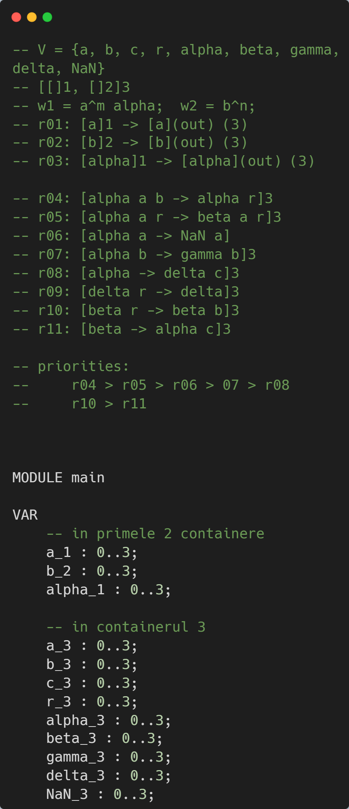
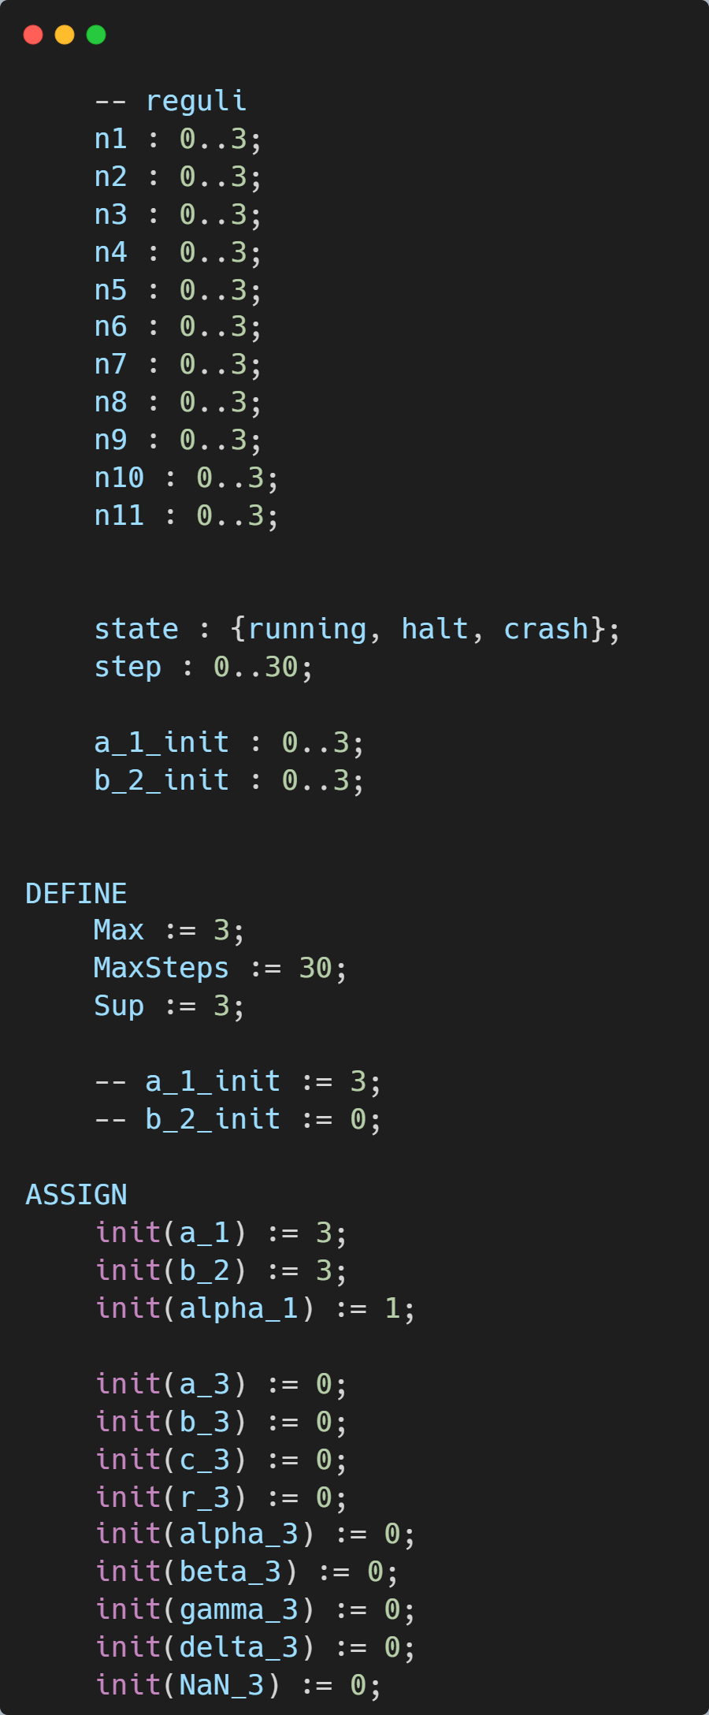
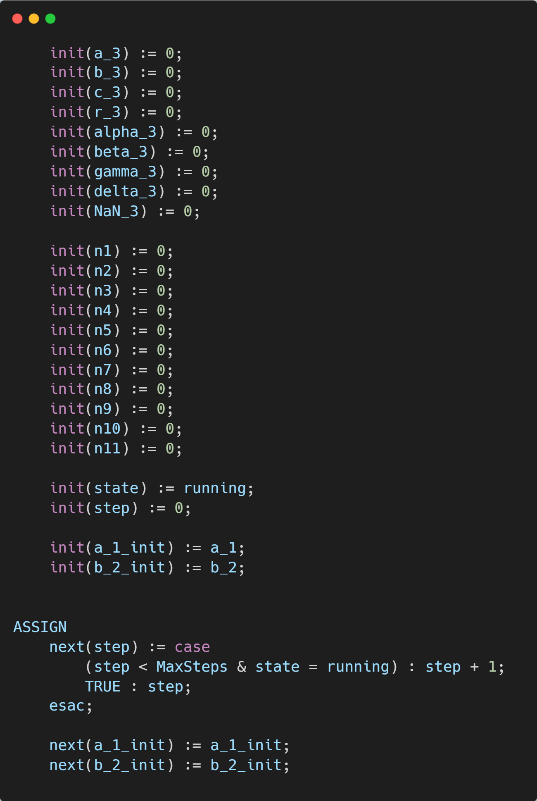
Codul NuSMV pentru operația de împărțire

Slide 18
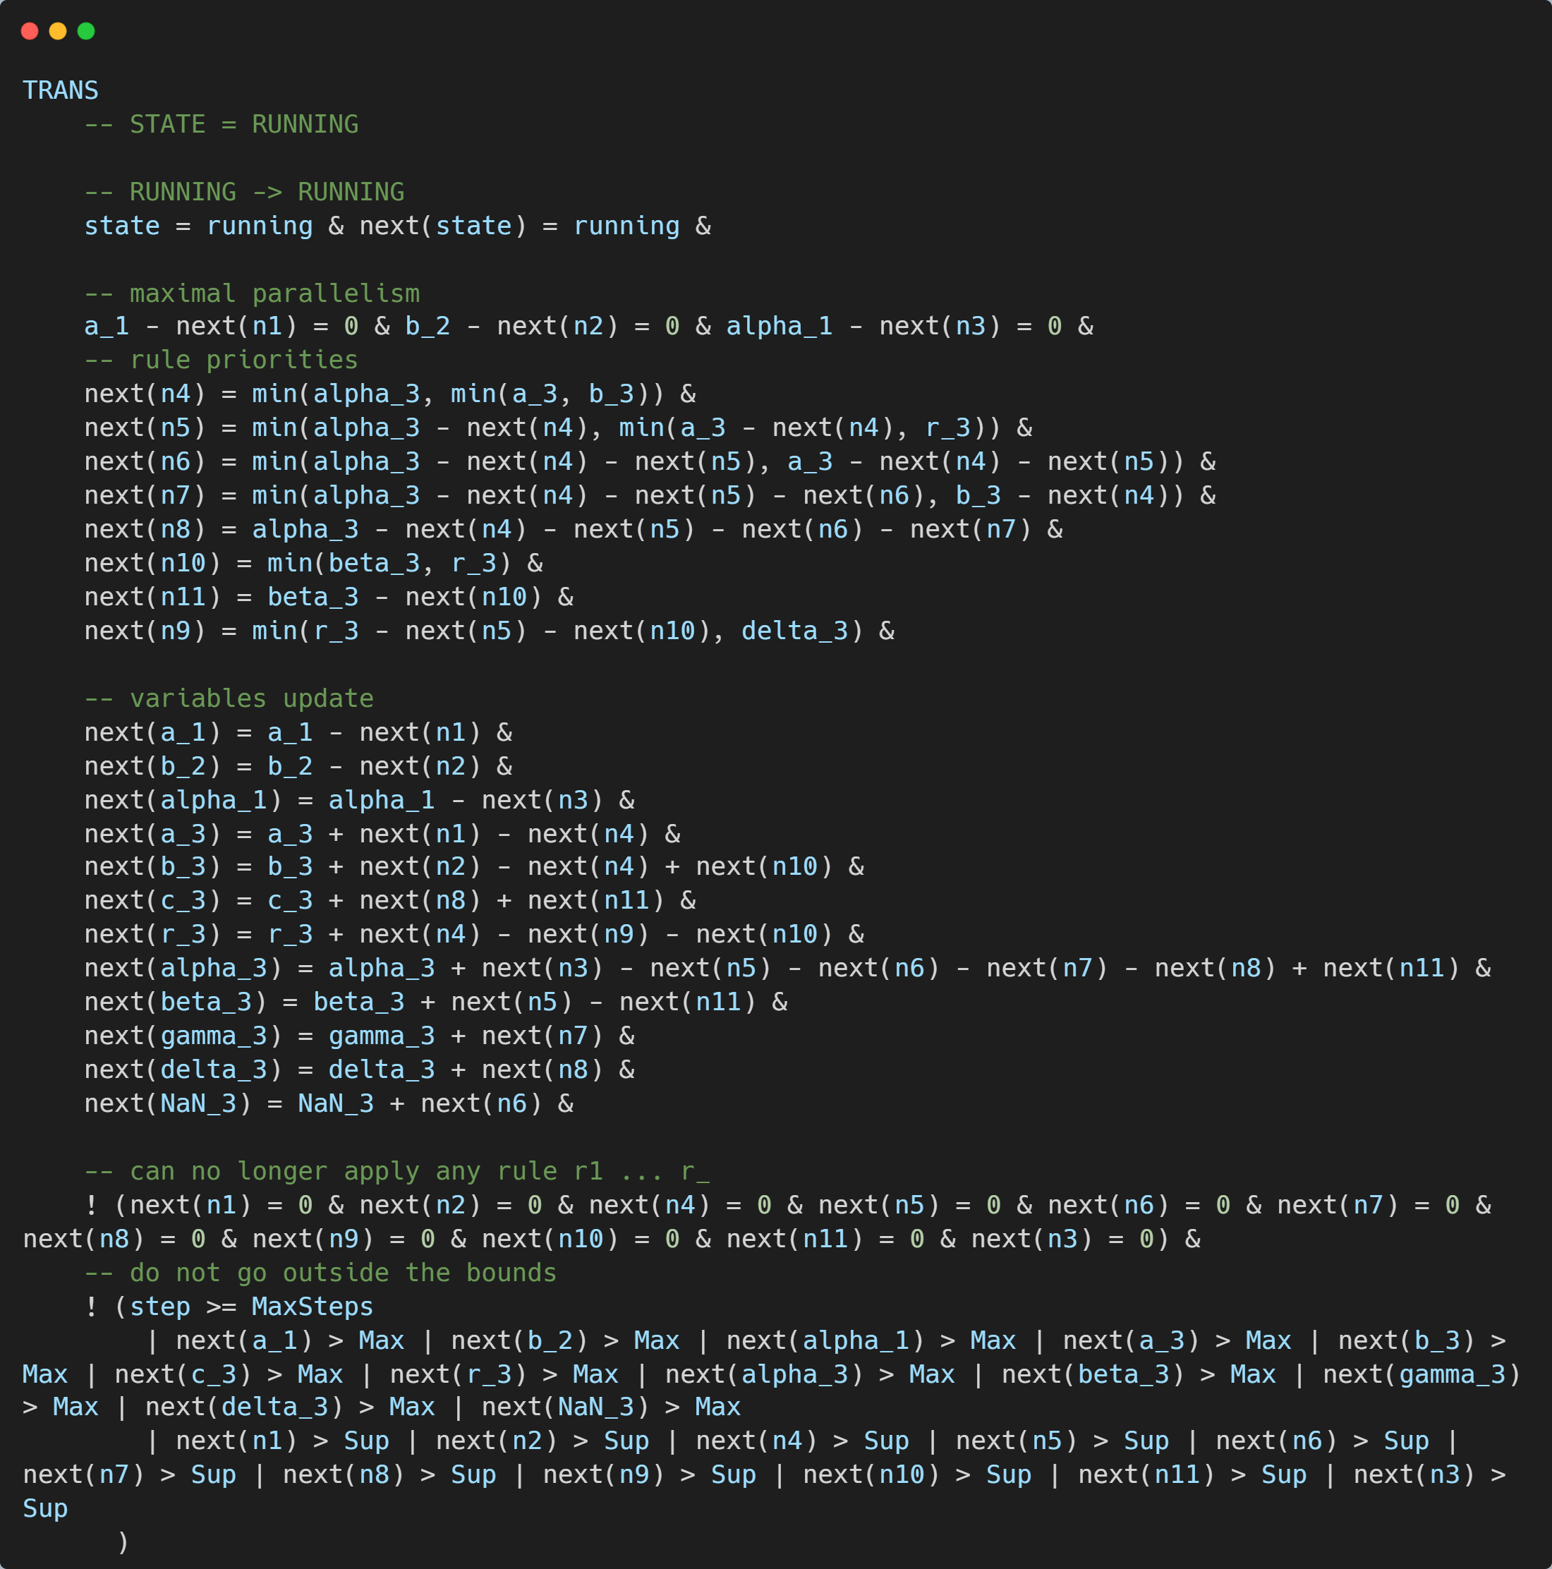
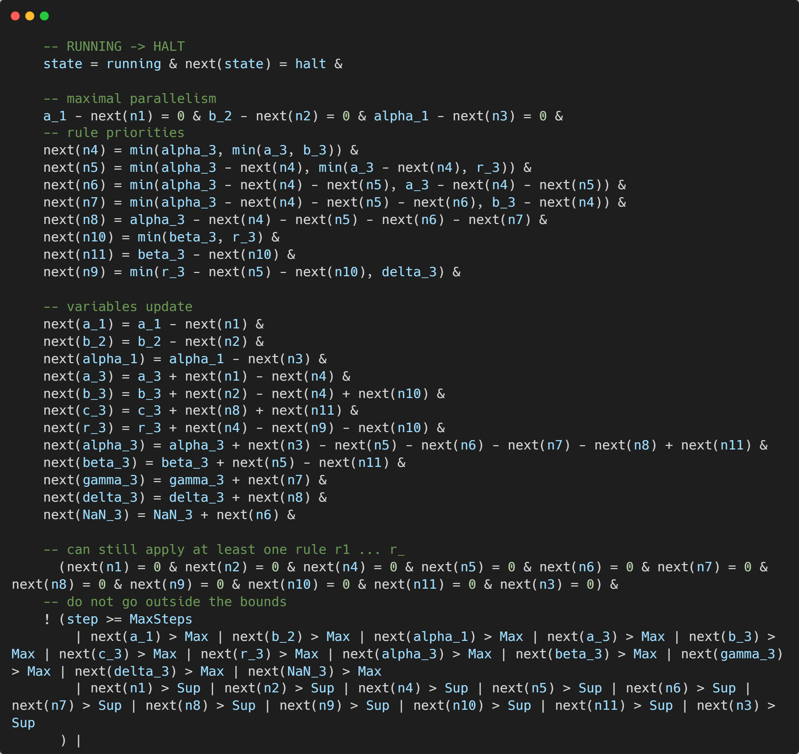

Slide 19
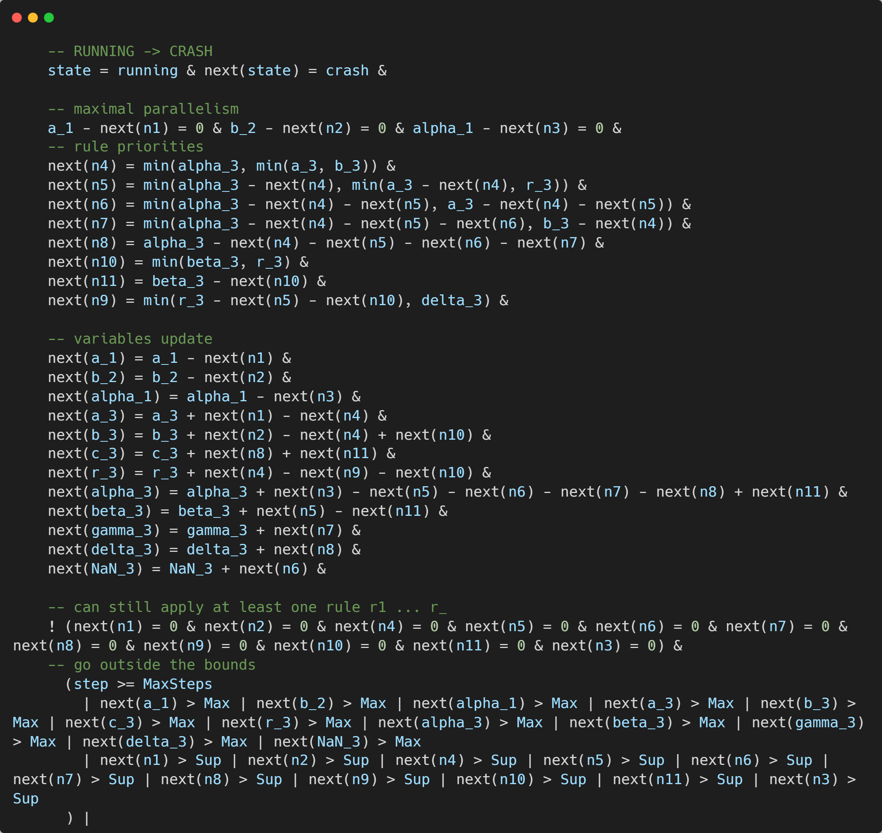

Slide 20
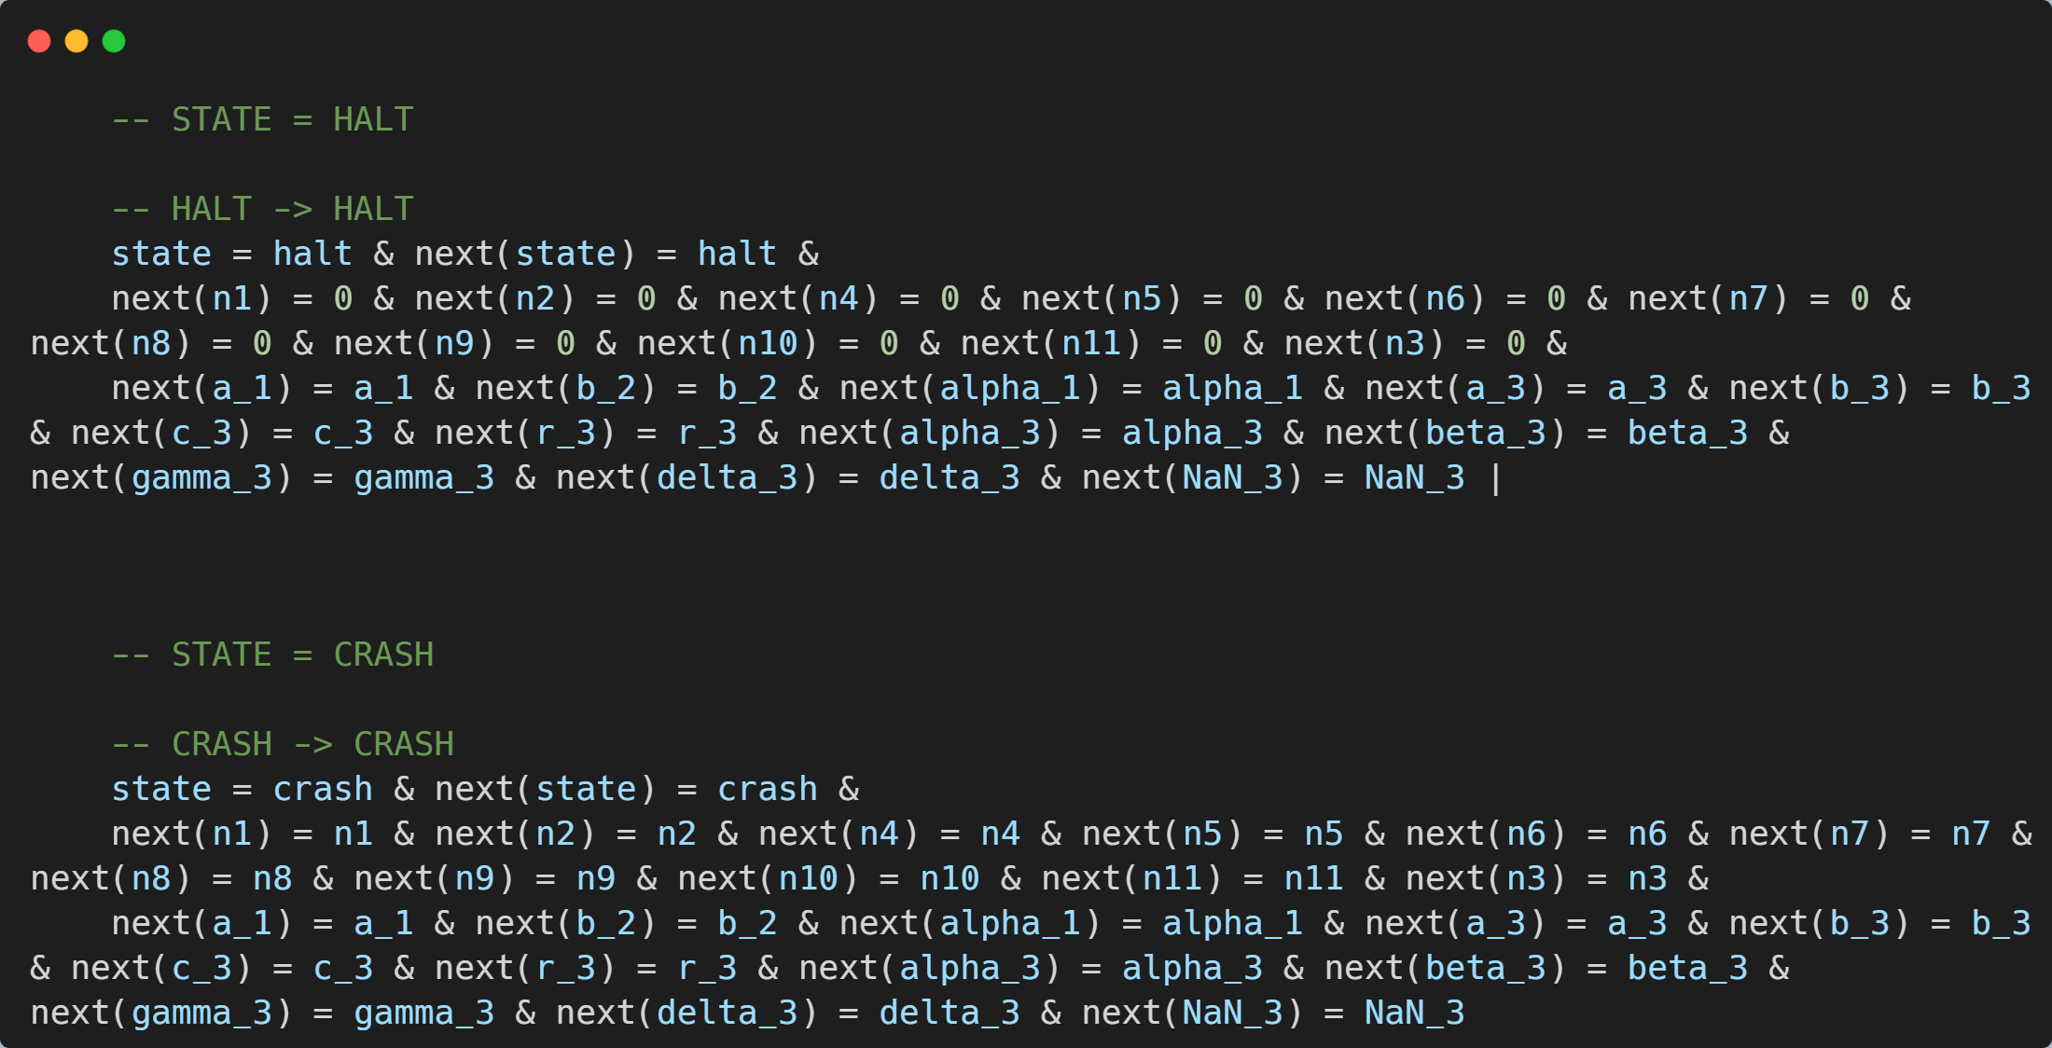

Slide 21
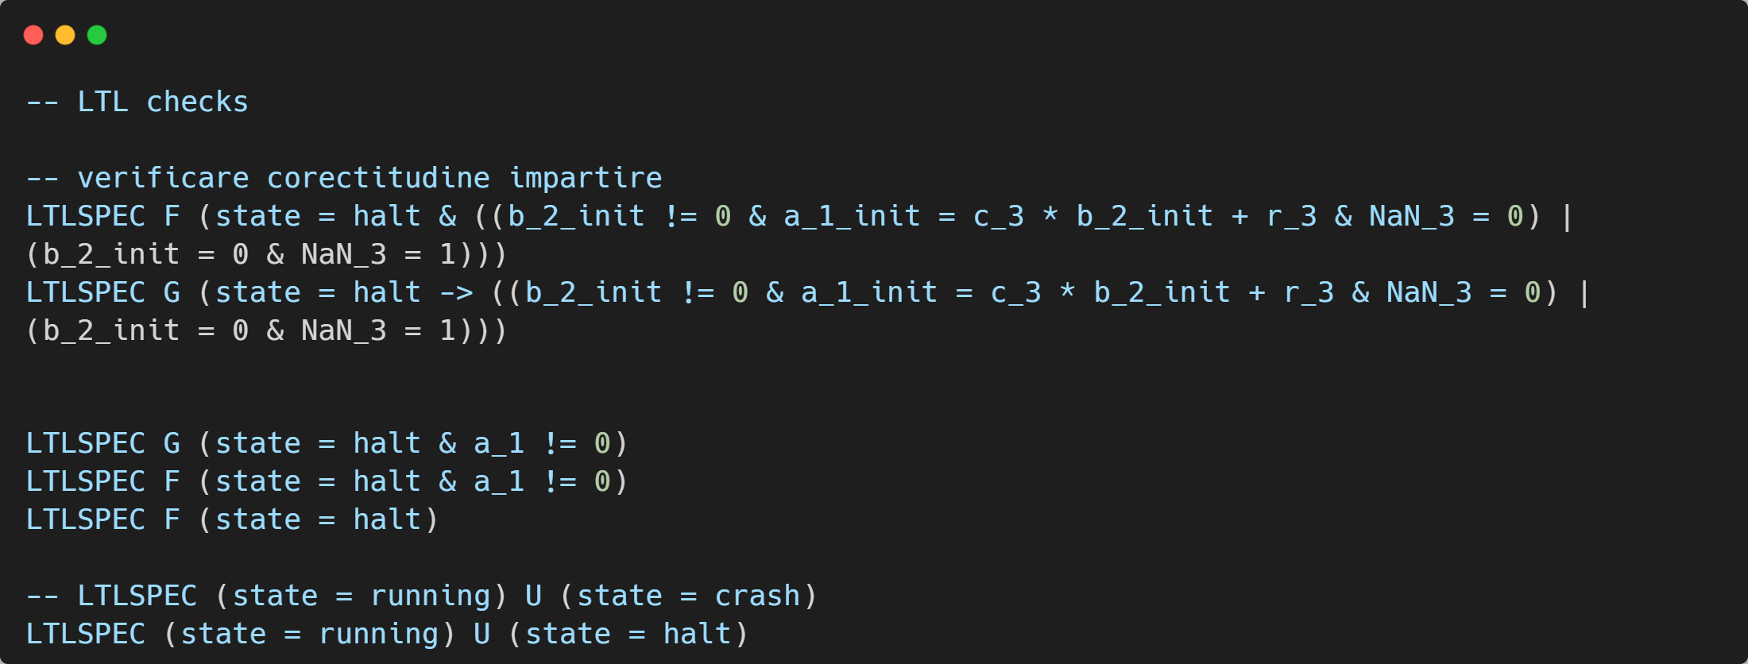

Slide 22
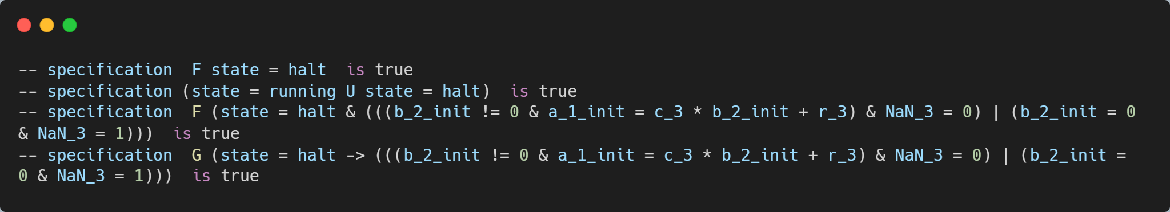
Rezultatul verificării sistemului

Slide 23
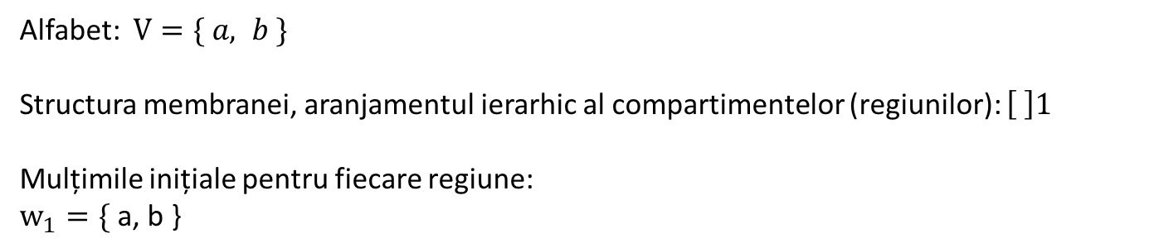
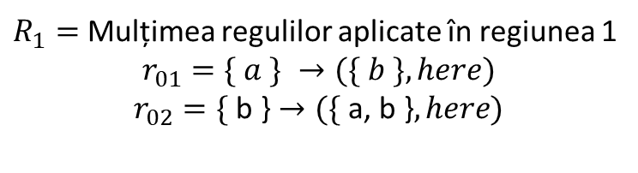

Numerele Fibonacci
Alfabet: $V=\{ a, b \}$
Structura membranei, aranjamentul ierarhic al compartimentelor (regiunilor): $\left[ \right]1$
Mulțimile inițiale pentru fiecare regiune:
$$w_{1}=\text{\{ }\text{a}\text{, }\text{b}\text{ \}}$$
$$\{ a, b \}$$
$R_{1}=$ Mulțimea regulilor aplicate în regiunea 1
$$r_{01}=\{ a \} →(\{ b \}, here)$$
$$r_{02}=\text{\{ }\text{b}\text{ \}}→(\text{\{ }\text{a}\text{, }\text{b}\text{ \}}, here)$$

Slide 24




Exemplu pentru numerele Fibonacci
$$\{ a, b \}$$
$$\{ a, b^{2} \}$$
$$Pasul \text{1}$$
Aplicăm operațiile:
$r_{01}=\left\{ a \right\}→\left(\left\{ b \right\}, here\right)$ de x1 ori
$r_{02}=\text{\{ }\text{b}\text{ \}}→(\text{\{ }\text{a}\text{, }\text{b}\text{ \}}, here)$ de x1 ori

Slide 25



Exemplu pentru numerele Fibonacci
$$\{ a, b^{2} \}$$
$$\{ a^{2}, b^{3} \}$$
$$Pasul 2$$
Aplicăm operațiile:
$r_{01}=\left\{ a \right\}→\left(\left\{ b \right\}, here\right)$ de x1 ori
$r_{02}=\text{\{ }\text{b}\text{ \}}→(\text{\{ }\text{a}\text{, }\text{b}\text{ \}}, here)$ de x2 ori

Slide 26


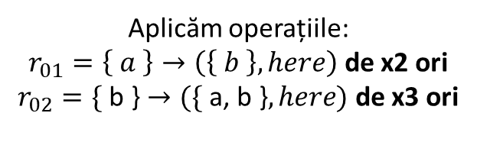

Exemplu pentru numerele Fibonacci
$$\{ a^{2}, b^{3} \}$$
$$\{ a^{3}, b^{5} \}$$
$$Pasul 3$$
Aplicăm operațiile:
$r_{01}=\left\{ a \right\}→\left(\left\{ b \right\}, here\right)$ de x2 ori
$r_{02}=\text{\{ }\text{b}\text{ \}}→(\text{\{ }\text{a}\text{, }\text{b}\text{ \}}, here)$ de x3 ori

Slide 27


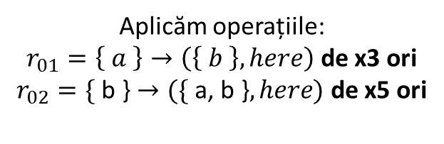

Exemplu pentru numerele Fibonacci
$$\{ a^{3}, b^{5} \}$$
$$\{ a^{5}, b^{8} \}$$
$$Pasul 4$$
Aplicăm operațiile:
$r_{01}=\left\{ a \right\}→\left(\left\{ b \right\}, here\right)$ de x3 ori
$r_{02}=\text{\{ }\text{b}\text{ \}}→(\text{\{ }\text{a}\text{, }\text{b}\text{ \}}, here)$ de x5 ori

Slide 28


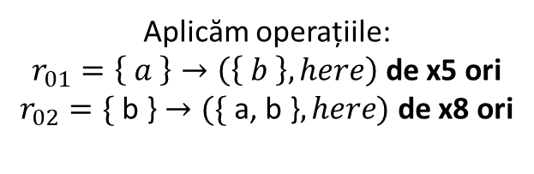

Exemplu pentru numerele Fibonacci
$$\{ a^{5}, b^{8} \}$$
$$\{ a^{8}, b^{13} \}$$
$$Pasul 5$$
Aplicăm operațiile:
$r_{01}=\left\{ a \right\}→\left(\left\{ b \right\}, here\right)$ de x5 ori
$r_{02}=\text{\{ }\text{b}\text{ \}}→(\text{\{ }\text{a}\text{, }\text{b}\text{ \}}, here)$ de x8 ori

Slide 29
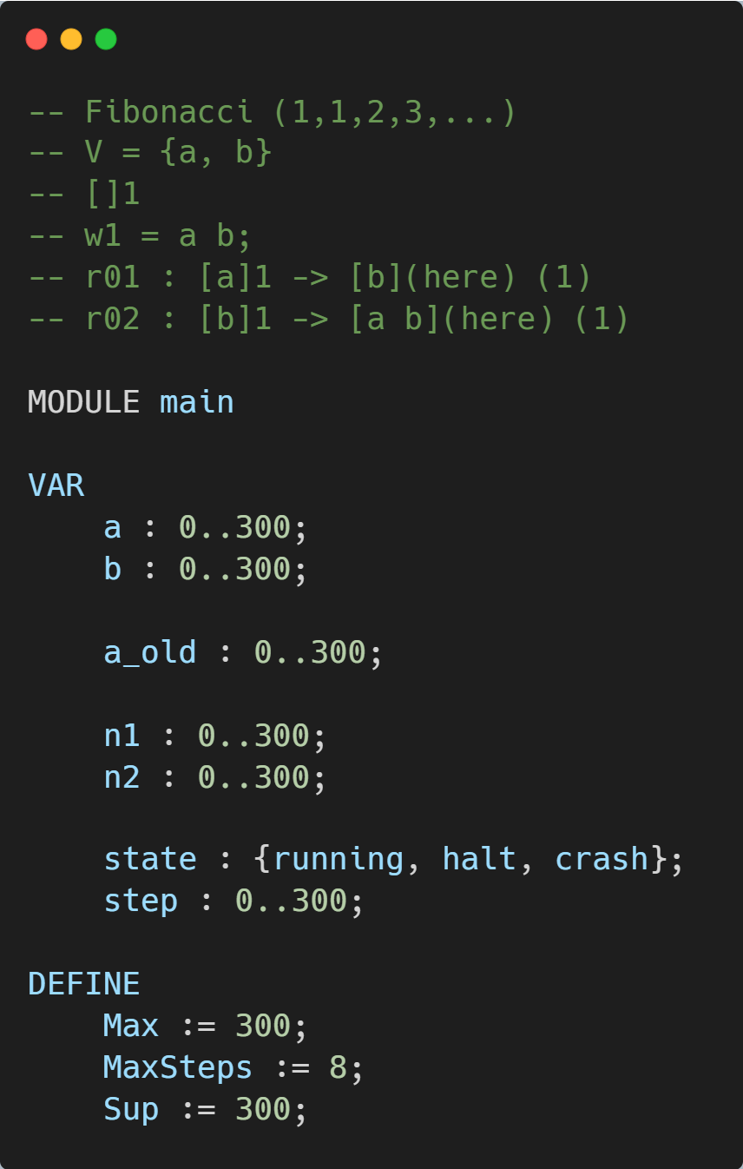
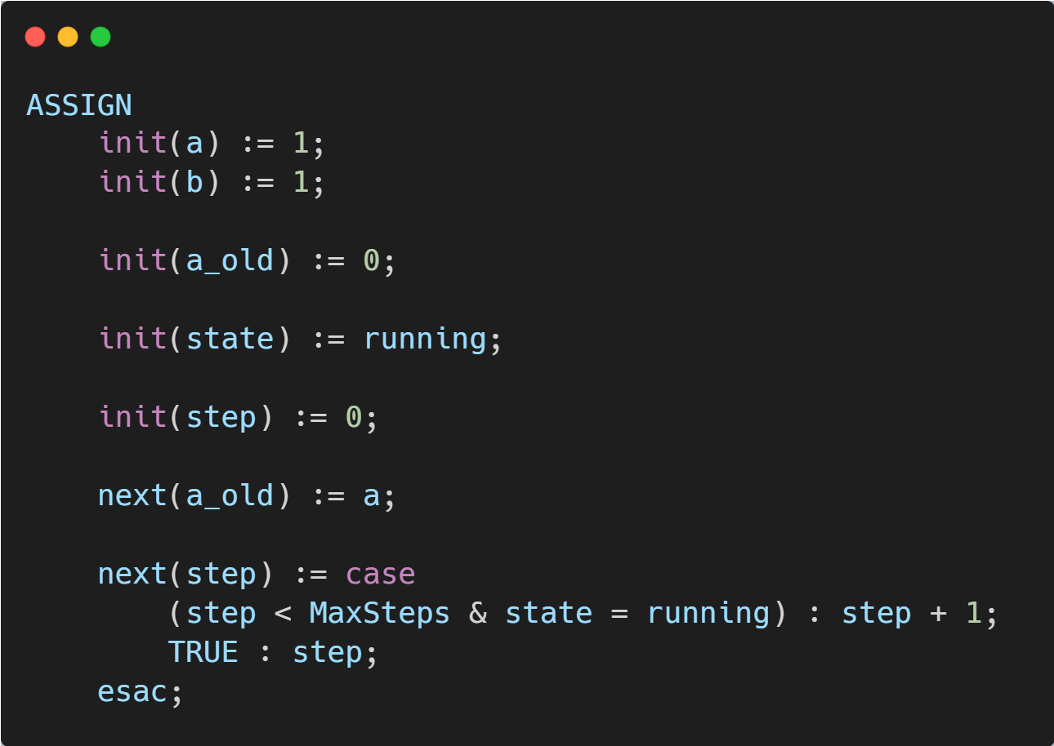
Codul NuSMV pentru numerele Fibonacci

Slide 30
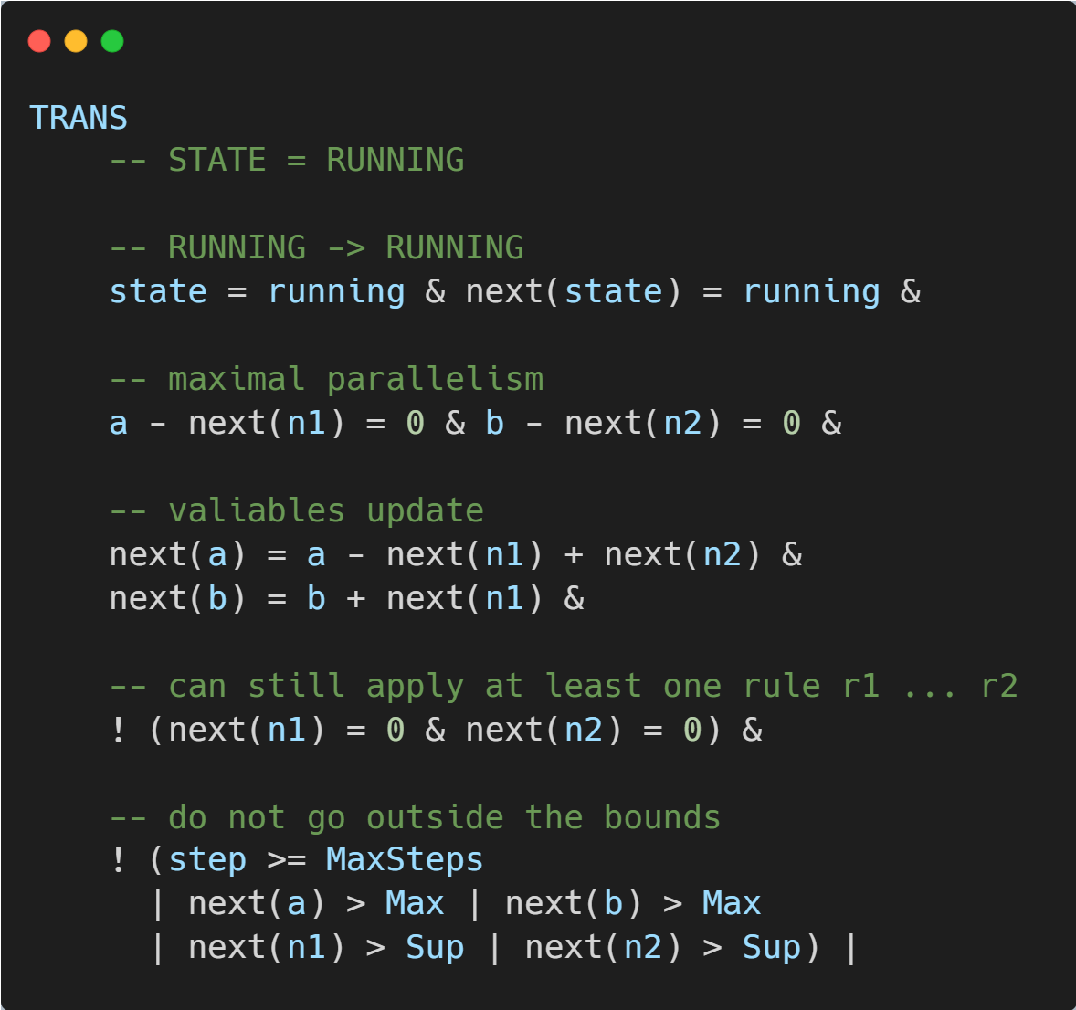
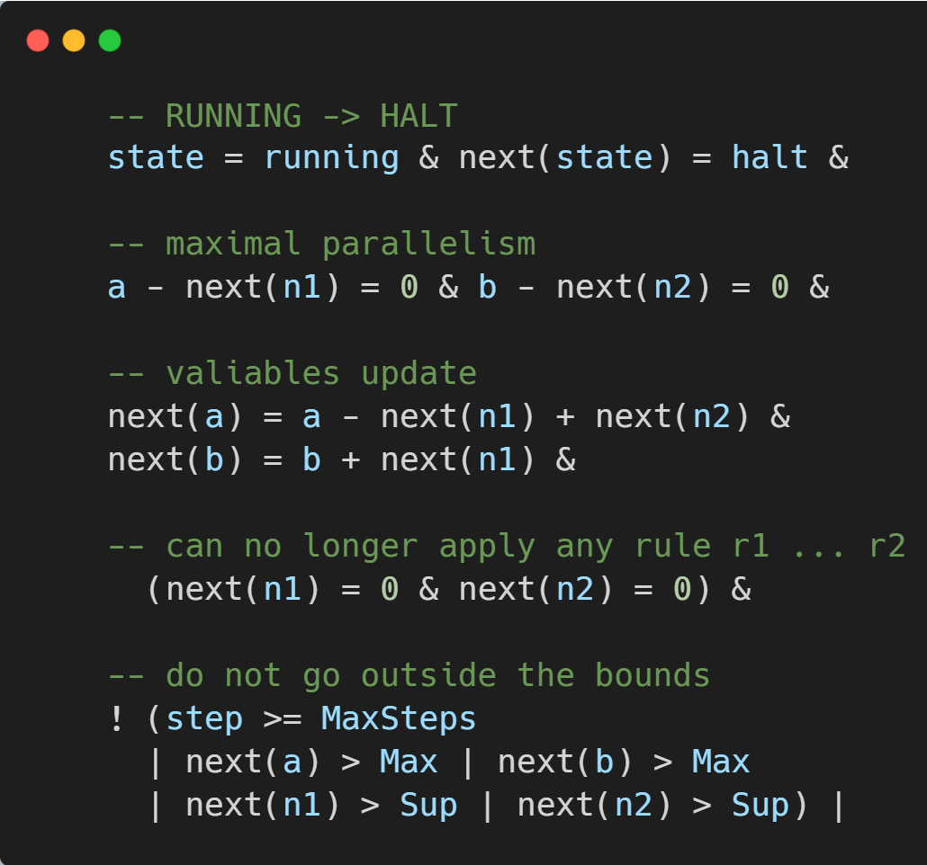

Slide 31
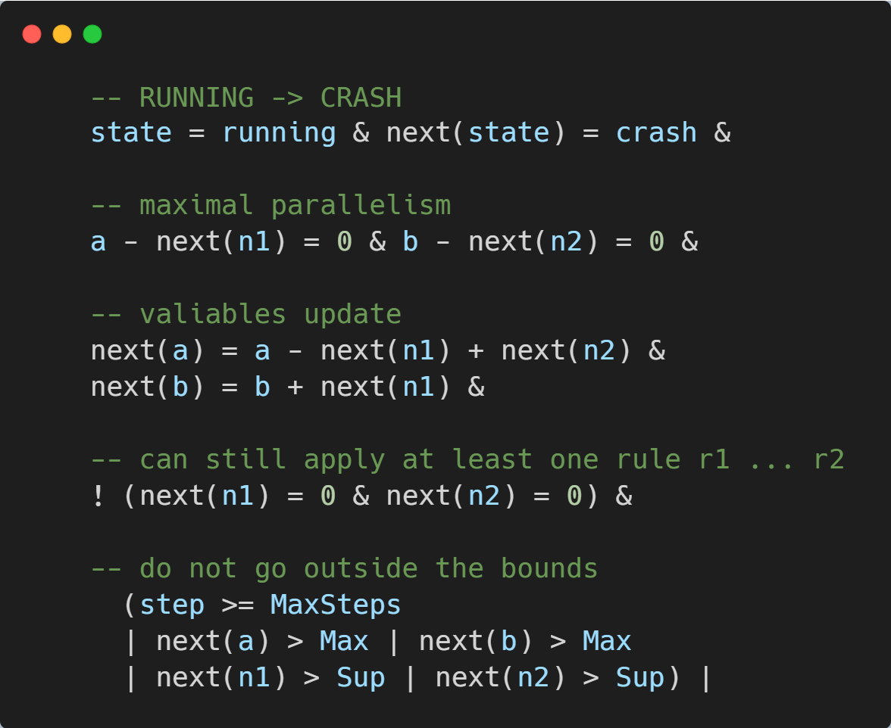
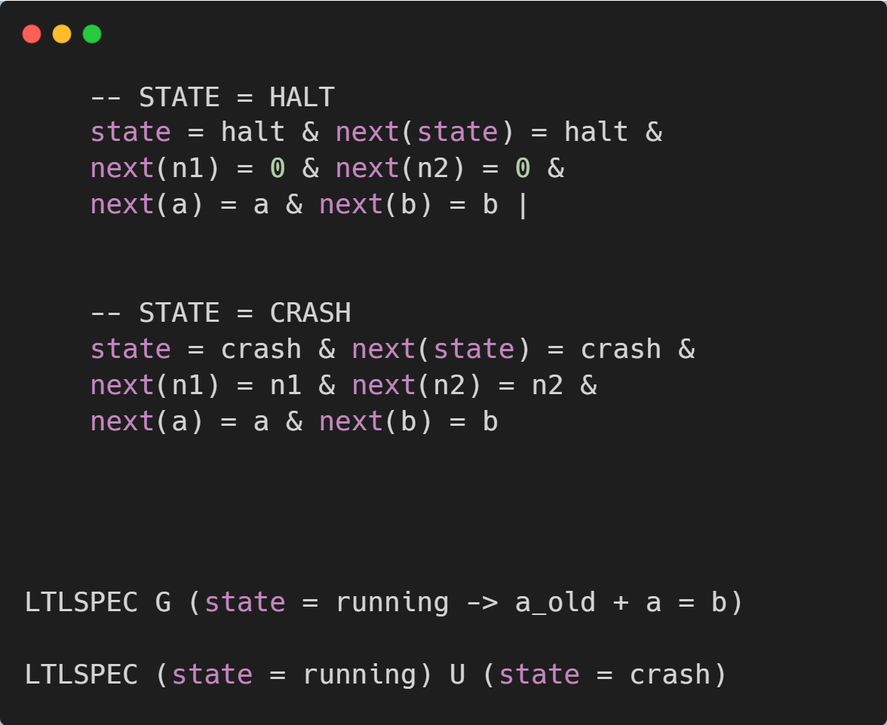

Slide 32
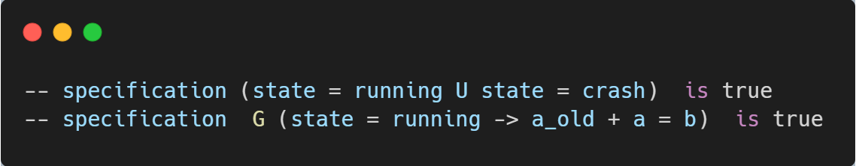
Rezultatul verificării sistemului

Slide 33
Bibliografie
An integrated approach to P systems formal verification
https://nusmv.fbk.eu/

